Slide 1

6th Grade Math
Unit 9, Lesson 9 Comparing Distributions Volume 2, pg. 193

Slide 2


Benchmarks
MA.6.DP.1.2
Given a numerical data set within a real-world context, find and interpret mean, median, mode, and range.
MA.6.DP.1.4
Given a histogram or line plot within a real-world context, qualitatively describe and interpret the spread and distribution of the data, including any symmetry, skewness, gaps, clusters, outliers, and the range.
volume 2, pg. 193

Slide 3
Integrated Mathematical Thinking and Reasoning Standards
MA.K12.MTR.2.1 Demonstrate understanding by representing problems in multiple ways.
MA.K12.MTR.4.1 Engage in discussions that reflect on the mathematical thinking of self and others.
MA.K12.MTR.6.1 Assess the reasonableness of solutions.
MA.K12.MTR.7.1 Apply mathematics to real-world contexts.
volume 2, pg. 193

Slide 4

Learning Targets
I can find and interpret mean and median of data sets.
I can use mean and median to compare data sets.
I can compare the distribution of data sets.
volume 2, pg. 193

Slide 5

Warm-Up
volume 2, pg. 194

Slide 6
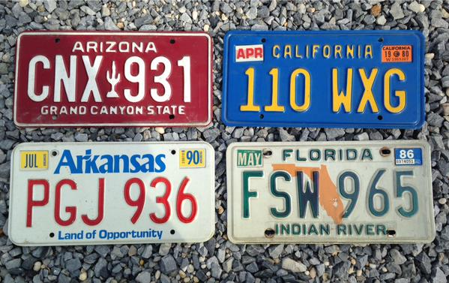
9.9.1 Warm-Up: Which One Doesn’t Belong?
Which license plate doesn’t belong? Explain your reasoning.
volume 2, pg. 194

Slide 7

Collaboration
volume 2, pg. 194

Slide 8

9.9.2 Collaboration: Comparing Distributions
Clare recorded the amount of time students in the sixth, eighth, and tenth grades spent doing homework in hours per week. She made a line plot of the data for each grade and provided the following summary.
Students in sixth grade tend to spend less time on homework than students in eighth and tenth grades.
The homework times for the tenth-grade students are more alike than the homework times for the eighth-grade students.
volume 2, pg. 194

Slide 9
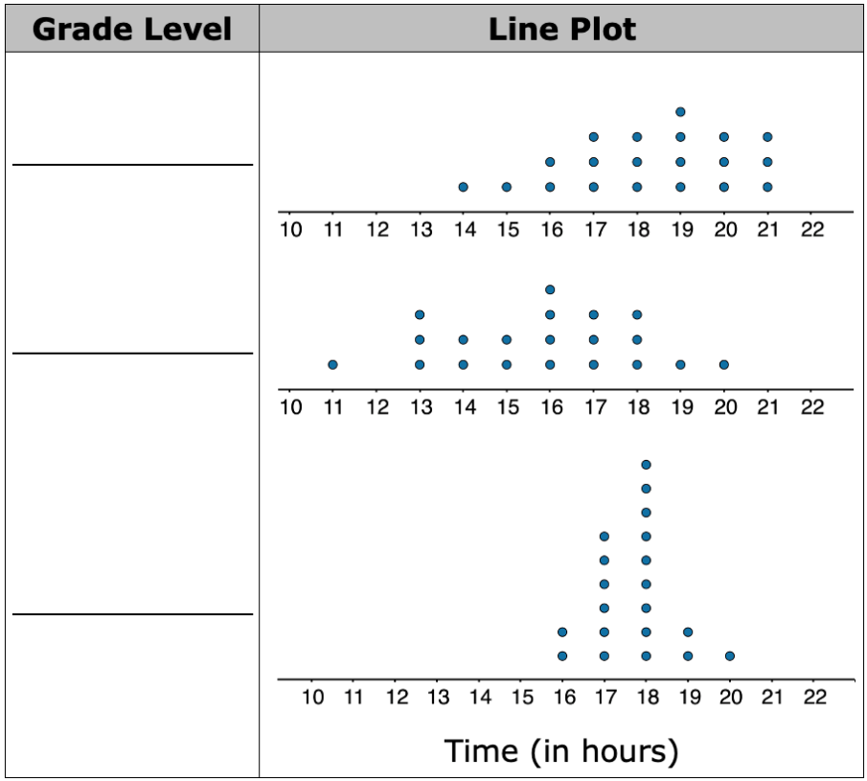
Use Clare's summary to match each line plot to the correct grade (sixth, eighth, or tenth).
volume 2, pg. 194

Slide 10

Guided Practice
volume 2, pg. 195

Slide 11

9.9.3 Guided Practice: Comparing Distributions
A histogram and line plot of the number of goals scored by the top 15 women goal scorers during the 2019‑2020 NCAA Women’s Division 1 soccer season are shown.
2019-2020 NCAA Women’s Division 1 Soccer Top Scorers
Frequency
Number of Goals
Number of Goals
volume 2, pg. 195

Slide 12
histogram
line plot
histogram and line plot
The can be used to
determine the mean.
The can be used to
determine the median.
Which measure of central tendency do you expect to be larger, the mean or the median? Explain your reasoning.
histogram
line plot
histogram and line plot
volume 2, pg. 195

Slide 13
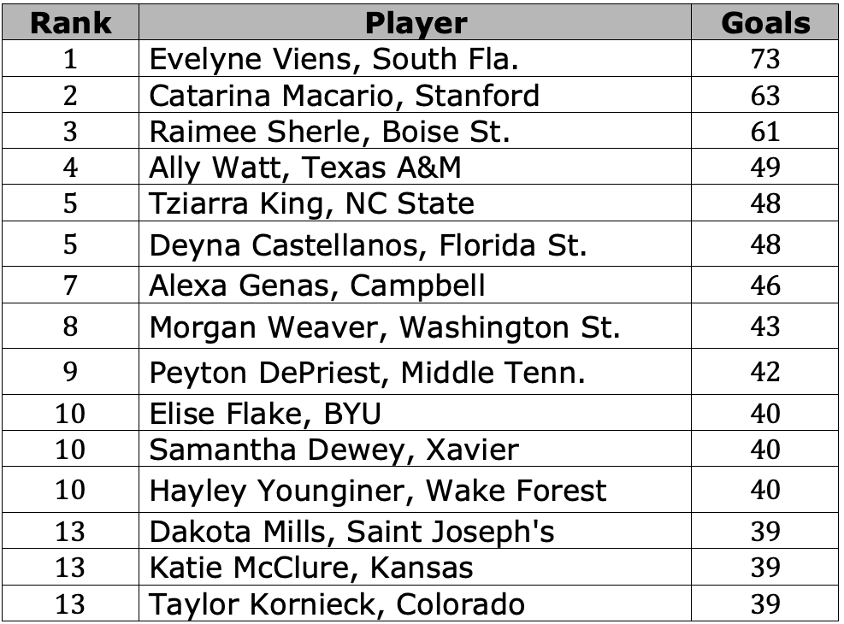
The table lists the data for the top 15 women goal scorers during the 2019-2020 NCAA Women’s Division 1 soccer season.
volume 2, pg. 196

Slide 14
Find the mean number of goals. Interpret the mean.
Find the median number of goals. Interpret the median.
Which value is larger, the mean or the median?
volume 2, pg. 196

Slide 15
How would the mean and median change if you found the mean goals and median goals for the top 8 scorers?
Find the mean number of goals for the top 8 scorers.
Find the median number of goals for the top 8 scorers.
volume 2, pg. 196

Slide 16
Discuss with your partner how the measures of central tendency changed. Write your conclusion.
volume 2, pg. 196

Slide 17

Your Turn
volume 2, pg. 197

Slide 18
9.9.4 Your Turn!
The line plots show the top 15 women goal scorers during the 2016-2017 and 2019-2020 NCAA Women’s Division 1 soccer season.
2016-2017 Season
2019-2020 Season
Number of Goals
volume 2, pg. 197

Slide 19
What is different about the top 15 goal scorers during the 2016-2017 soccer season and the top 15 goal scorers during the 2019-2020 soccer season?
Make a hypothesis determining whether the mean of the 2019-2020 season or the mean of the 2016‑2017 season is higher. Explain what influenced your hypothesis.
volume 2, pg. 197

Slide 20
Make a hypothesis determining whether the median of the 2019-2020 season or the median of the 2016-2017 season is higher. Explain what influenced your hypothesis.
Compare your predictions with your partner’s predictions. Make any adjustments needed based on your conversation.
volume 2, pg. 197

Slide 21
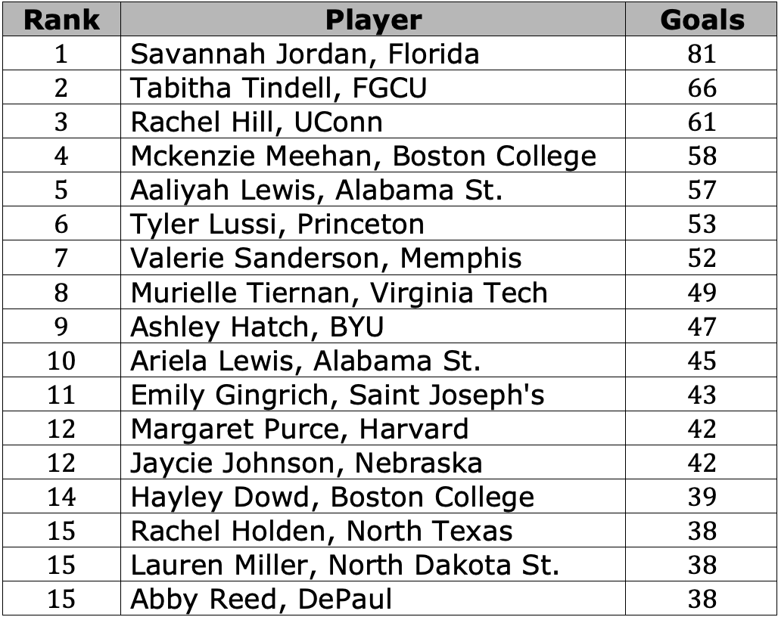
The table shows the list of the top 15 women goal scorers during the 2016-2017 NCAA Women’s Division 1 soccer season.
volume 2, pg. 198

Slide 22
Find the mean number of goals for the 2016-2017 soccer season.
Interpret the mean
volume 2, pg. 198

Slide 23
Find the median number of goals for the 2016-2017 soccer season.
Interpret the median.
volume 2, pg. 198

Slide 24
Complete the statements.
The mean of the 2016-2017 soccer season is
than the mean of the 2019-2020 soccer season. The
value in the soccer season that likely
influenced the mean is ________.
The median of the 2016-2017 soccer season is
than the median of the 2019-2020 soccer season.
less
greater
2016-2017
2019-2020
less
greater
volume 2, pg. 198

Slide 25

Wrap-Up
volume 2, pg. 199

Slide 26
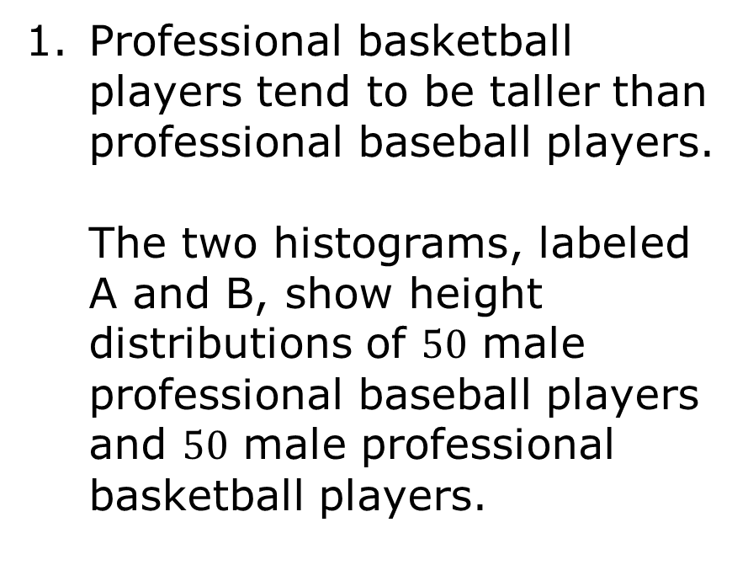
9.9.5 Wrap-Up: Ticket Out the Door
Professional basketball players tend to be taller than professional baseball players.
The two histograms, labeled A and B, show height distributions of $50$ male professional baseball players and $50$ male professional basketball players.
A
B
Height (in inches)
volume 2, pg. 199

Slide 27
Choose one of the titles: “Heights of Baseball Players” or “Heights of Basketball Players” for each histogram.
Describe the spread and shape of the distribution of the heights of the basketball players.
Histogram | A | B
Best Title
volume 2, pg. 199

